Slide 1

Notice to follow
Dear colleagues,
It is to draw your kind attention that all the structures are two times triggered. Firstly you have to click on the option of the structure one after another than you have to click again as the same way. You will find two examples accordingly. If you observe it before presentation in the class, it will be better for you. If you find any lacking, recover it yourself. In case of any inquiry please call 01714529249.
Komal Kanta Ray Talukder
L.P.High School,Chhatak.
Notes:
Please follow this option carefully before going to present the content in the class room.

Slide 2

Welcome
Notes:
Welcome slide.

Slide 3

Introduction
Komal Kanta Ray Talukder
MA,BEd AHM
L.P.School & College
Chhatak,Sunamgonj.
Class VI-IX
English 2nd Paper
Grammar
Notes:
Identity & introduction

Slide 4

Let’s enjoy
What an exciting water game it is!
How amazing the show is!
Notes:
Suspension.

Slide 5
What kind of sentence have you observed?
Exclamatory Sentence
Notes:
Leading to lesson declaration.

Slide 6

Our today’s lesson is-
Exclamatory
Sentence
Notes:
Lesson declaration.

Slide 7

Learning outcomes
At the end of the lesson, we will be able to –
identify the definition of exclamatory sentence
identify the structure of exclamatory sentence
rearrange the jumble words to make exclamatory sentences
make exclamatory sentences with clues
Notes:
The above points will be achieved by this lesson.

Slide 8

What is an Exclamatory Sentence?
What a beautiful flower it is!
How beautiful the flower is!
The sentence that expresses something surprising, amazing
and abnormal feelings are called exclamatory sentences.
Notes:
Definition with example.

Slide 9

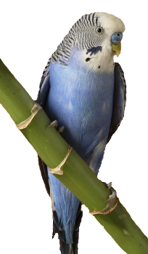
Formation of Exclamatory sentence-1
+
+
+
What a/an or How
Subject
+
Adjective
Verb
!
What a
beautiful bird
it
is
!
How
beautiful
the bird
is
!
Notes:
The structure is triggered twice. It shows two examples one after another.

Slide 10


Formation of Exclamatory sentence-2
Exclamation word (Alas, Hurrah, Oh)
!
+
Assertive sentence
+
Alas
!
I am undone.
Hurrah
!
We have won the match.
Notes:
The structure is triggered twice. It shows two examples one after another.

Slide 11

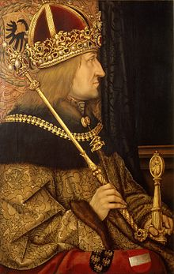
Formation of Exclamatory sentence-2
If/Had
+
Subject
+
Verb
+
Extension
+
!
a king
If
I
were
!
Had
I
been
a rich man
!
Notes:
The structure is triggered twice. It shows two examples one after another.

Slide 12
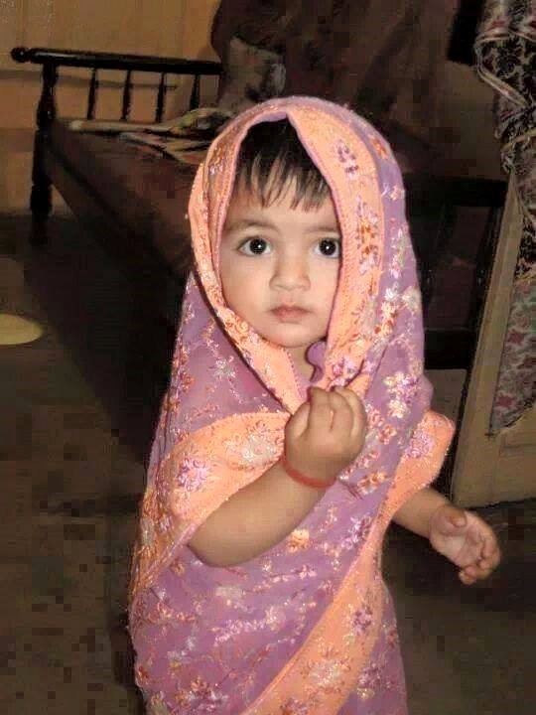
Formation of Exclamatory sentence-3
Would that
+
Assertive sentence !
Would that
I could be a child again !
Notes:
The structure is triggered twice. It shows two examples one after another.

Slide 13
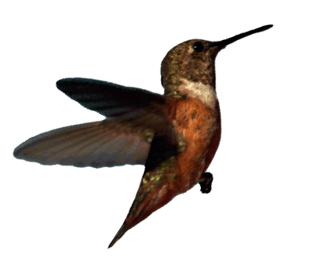
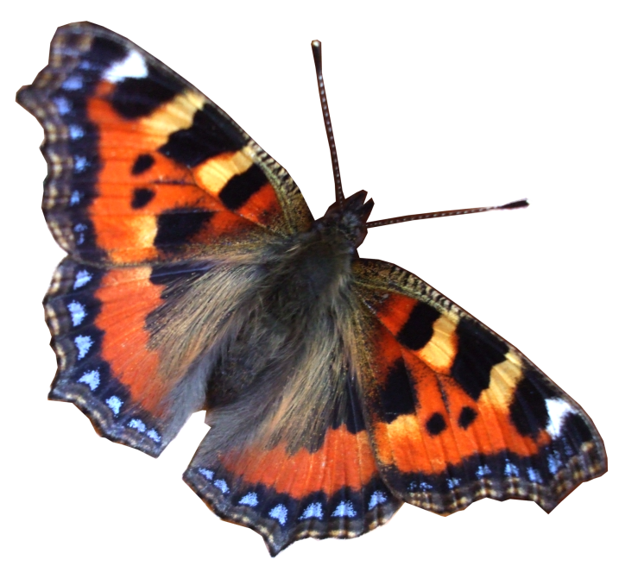

Rearrange the jumbled words to
make exclamatory sentences.
a it, beautiful, frame, what, is, !
nice, the, frame, how, is,!
I, wings a, of, had, the, bird,!
I, that, be, again, child, I, would, could, a, !
were, if, a, I, butterfly!
Notes:
Evaluation in the class.

Slide 14


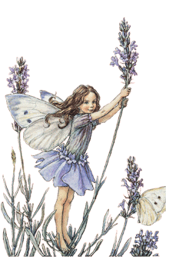
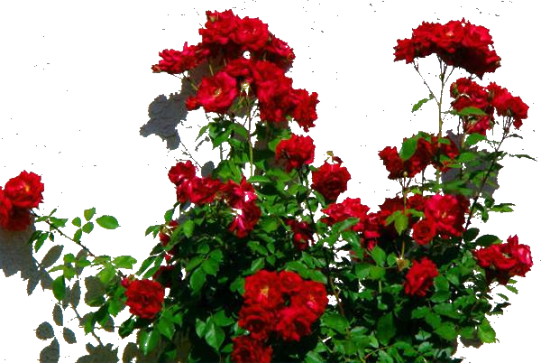
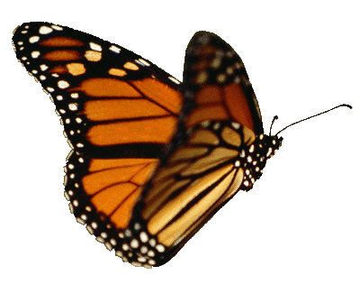
Make five exclamatory
sentences with the pictures
Notes:
Evaluation/Feedback

Slide 15

Notes:
Ending greeting.

